Slide 1
DKG Treasurers Talk
Essentials Form 990N

Slide 2
Form 990 is due November 15!
Which form should you file?
990N Chapters with annual gross receipts of $50,000 or less each year (average for 3 years). Can’t be filed late, due date can’t be extended.
990EZ Chapters with annual gross receipts less than $200,000 and total assets of less than $500,000. Return is due November 15, but a request for a 5-month extension can be filed.
990 (Long form) Chapters with gross receipts $200,000 or greater, or total assets of $500,000 or more. Return is due November 15 but a request for a 5-month extension can be filed.

Slide 3
What happens if you don’t file?
To maintain tax-exempt status chapters must have a valid filing in 1 out of 3 years for 990N.
990N only, 990EZ and 990 long form must be filed annually.
If chapter loses tax exempt status, they are considered a “for profit business” and will have to file a business income tax return.
Chapters who lose tax exempt status will fall out from DKG International’s group ruling. Chapter will have to apply for non-profit status independently – fee is $600.

Slide 4
Form 990N is Due November 15
No extensions!
Who can file:
Chapters with annual gross receipts of $50,000 or less each year (average for 3 years).
Form must be filed electronically on the IRS website, there is no fee to file.
Late filings of 990N are not allowed.

Slide 5
Form 990N Tips and Tricks
Make sure you are on the IRS website
IRS site can be accessed from DKG website, login for DKG website is not the same login for IRS.
IRS site can be accessed from irs.gov then clicking on “Charities & Nonprofits”.
If you are being charged a fee to file you are not on the IRS website.

Slide 6
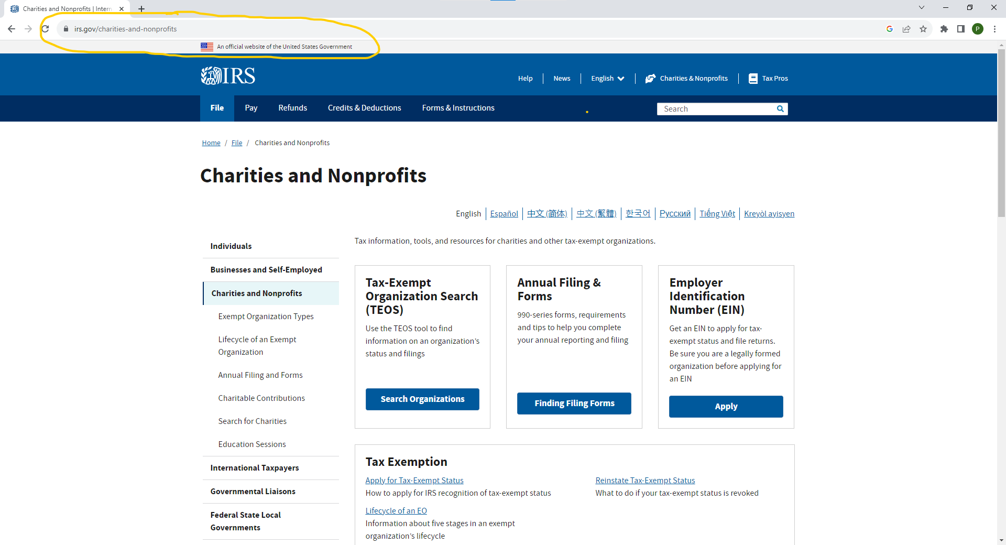

Slide 7
Return itself is simple, most common problem is logging in to IRS filing system
Each treasurer needs to create their own account. Accounts are tied to an email address, passing on login doesn’t work well.
Login requires MFA (multifactor authentication), to create account treasurer needs to have access to email or phone.
IRS does not work well with Safari browser, if you are using an iPad, IPhone or Mac access via Google Chrome or Microsoft Edge(?)

Slide 8
To file treasurers need
EIN (TIN) for chapter.
Name and address for responsible party, usually president or treasurer.
Mailing address for chapter usually, president’s or treasurer’s. This is the address notices will be sent to.
Optional dba (doing business as) this field is not required, however if treasurer fill it in, we recommend using two letter state and chapters Greek name.
Example: Alabama Alpha chapter would enter AL Alpha Chapter.

Slide 9
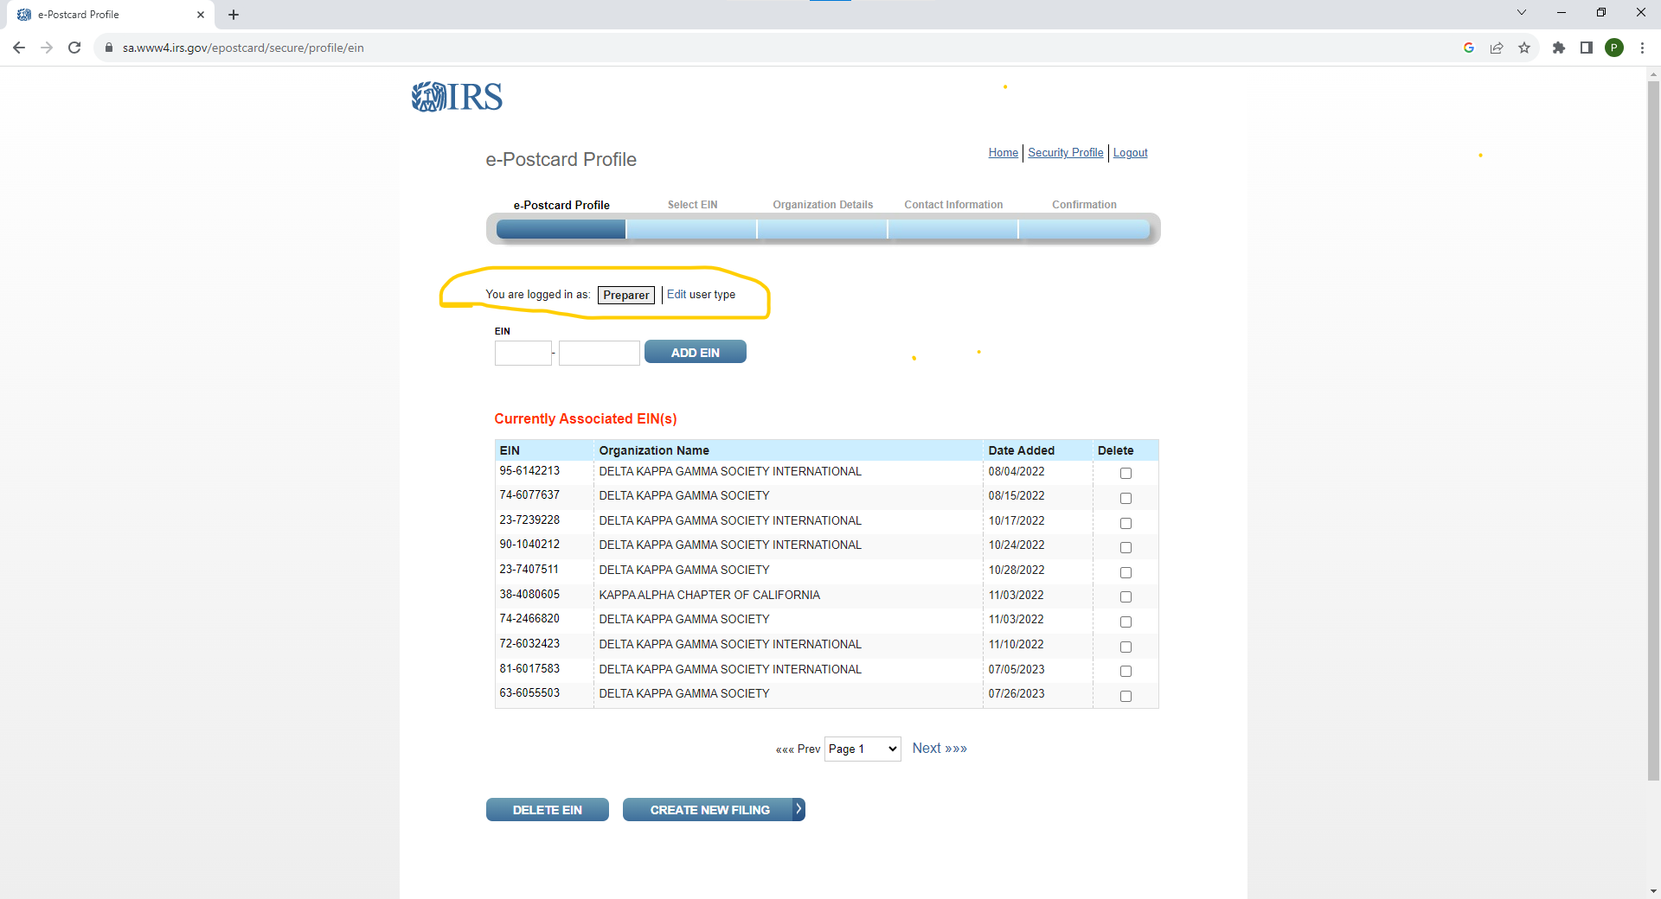
Common problems filing
(besides logging in)
IRS removed the default for user type under MANAGE E-POSTCARD PROFILE – little grey box appeared need to select “Exempt Organization”

Slide 10
Common problems filing
(besides logging in)
Punctuation in address fields
IRS system will not accept any punctuation or special characters in address fields
NO # , . @ or & /

Slide 11
Please ask for help when needed
We understand this process can be frustrating
BEFORE CALLING THE IRS try contacting headquarters
Email Bill Staples bills@dkg.org or Peggy Jonas peggyj@dkg.org
Call Headquarters phone at 512-478-5748

Slide 12
Question and Answer
Time

